Slide 1
Second language learning and models of lexical access

Slide 2
Overview
Saussure’s (1916) model of lexical organisation
What word associations can tell us about the lexicon
Levelt’s (1989) blueprint of the speaker
Lexical access in bilinguals and L2 learners
Revised Hierarchical model (Kroll & Stewart, 1997)
Modified Hierarchical model (Pavlenko, 2009)
Models of lexical access in L2 learners (Jiang, 2000)
Implications for practice

Slide 3
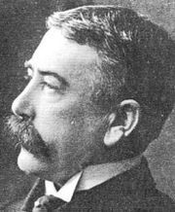
Langue and parole
langue (social, abstract) - a system of signs
parole (individual, concrete)
These two together form "le langage“ (language)
The object of Linguistics: langue
Ferdinand de Saussure (1857-1913)
Notes:
Chomsky: competence – not only the linguistic system but also the speaker’s knowledge of it. Adds a cognitive dimension.
Saussure: distinction between a social norm
and individual manifestations of that norm.
Knowledge is partial and incomplete

Slide 4
Langue and parole
Langue is the social part of language, outside the speaker, who cannot create or modify it. But the signs are concrete.
A sentence is the typical unit of "parole"
Langue is a deposit of signs (passive)
Parole: active and individual

Slide 5
Differences between langue and parole
Langue Parole
unconscious conscious
nonwillful willful
passive active
homogeneous heterogeneous
Notes:
Because speaking involves choice — selection — it is willful, not just in
the sense of choosing what to say, but also how and when (or whether)
anything is said. Equivalently, speaking is a conscious activity, whereas
language is unconscious/nonwillful. Language never requires “premeditation”
(Saussure 1959:14) while speaking does.

Slide 6
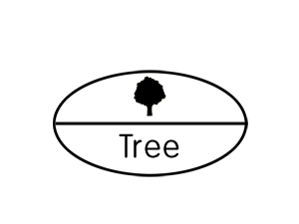
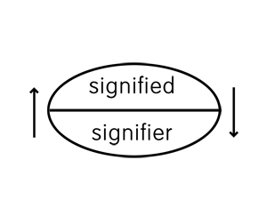
Meaning of words
A word is a sign
Arbitrary link between sound and concept
Meaning different from referent
Notes:
Saussure's most influential work, Course in General Linguistics (Cours de linguistique générale), was published posthumously in 1916 by former students Charles Bally and Albert Sechehaye on the basis of notes taken from Saussure's lectures at the University of Geneva. The Course became one of the seminal linguistics works of the 20th century, not primarily for the content (many of the ideas had been anticipated in the works of other 19th century linguists), but rather for the innovative approach that Saussure applied in discussing linguistic phenomena.

Slide 7
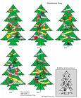

trees

Slide 8
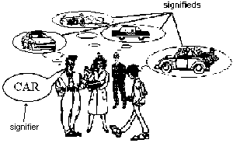
Signifier - signifieds
Word “car” linked to different mental images.

Slide 9
Syntagmatic relations
The relation between the words in a sentence
"The squirrel bit the student"
"The student bit the squirrel“
English
"The adjectival noun verbed the direct object adverbially."
French
"The noun adjectival verbed adverbially the direct object ."

Slide 10
Associative links
Signs are stored in memory not in syntagmatic links or sentences, but in ASSOCIATIVE groups
ASSOCIATIVE relations are only in the mind, not in the structure of language itself, whereas SYNTAGMATIC relations are a product of linguistic structure.

Slide 11
Exercise
What associations do you have when you hear the following words:
1. sweet
2. storm
3. squeeze
How can we group these associations?
What do word associations tell us?
Notes:
Relationships between words?
Semantic distance between words.
to provide a psychologically credible basis for semantic linking between words
as a source of associations between ideas in advertising.

Slide 12
SWEET ant, cake, candies, child, memory, lover, smile, cavities
STORM wind, rain, debris, destroy, thunder, tornado, stone, dust
SQUEEZE lemon, orange, people, a tiny room, sponge, quiz

Slide 13
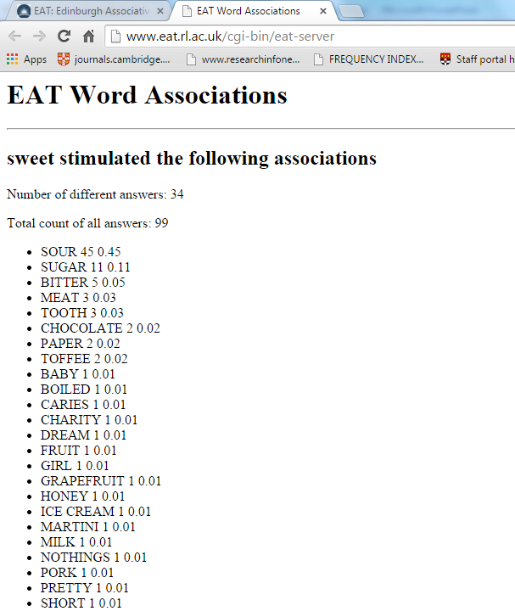
Word associations are language-specific. Which associations does the word “sweet” have in your first language?
Edinburgh associative thesaurus
http://vlado.fmf.uni-lj.si/pub/networks/data/dic/eat/Eat.htm#:~:text=The%20Edinburgh%20Associative%20Thesaurus%20(EAT,association%20as%20collected%20from%20subjects.

Slide 14
Word associations and lexical organisation
Words function in a semantic network of related words (Aitchison, 1994)
Differences in lexical knowledge can be thought of as differences in the number of connections and the type of connections between words (Meara & Wolter, 2004)

Slide 15
Syntagmatic and paradigmatic associations
Syntagmatic associations of dog: bark, spotty, naughty, bite
Paradigmatic associations of dog: wolf, cat, animal
Children prefer syntagmatic associations and clang associations (rhyming, assonances etc.)

Slide 16
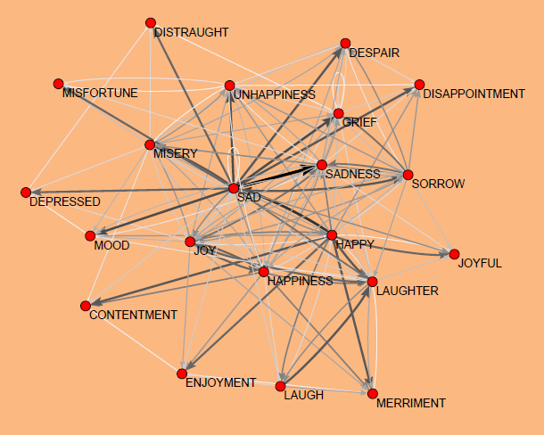
Words form part of networks
network of words linked to SAD from Zaversnik & Batagelj (2004)

Slide 17
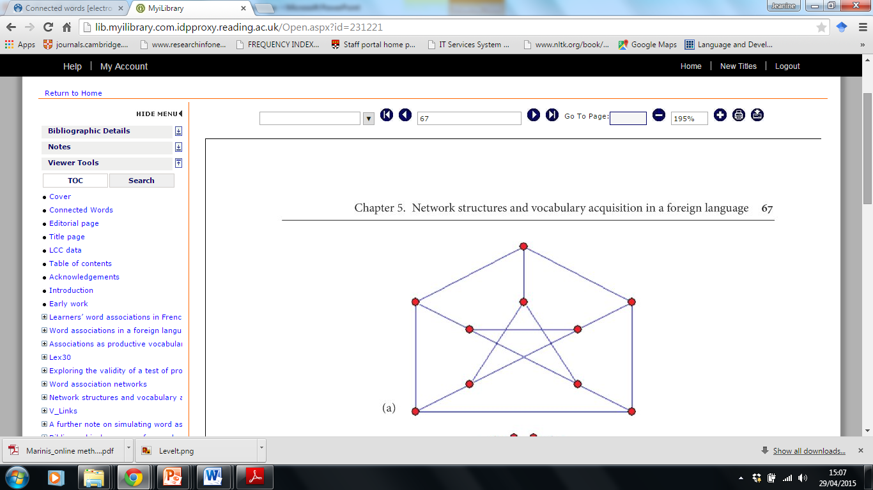
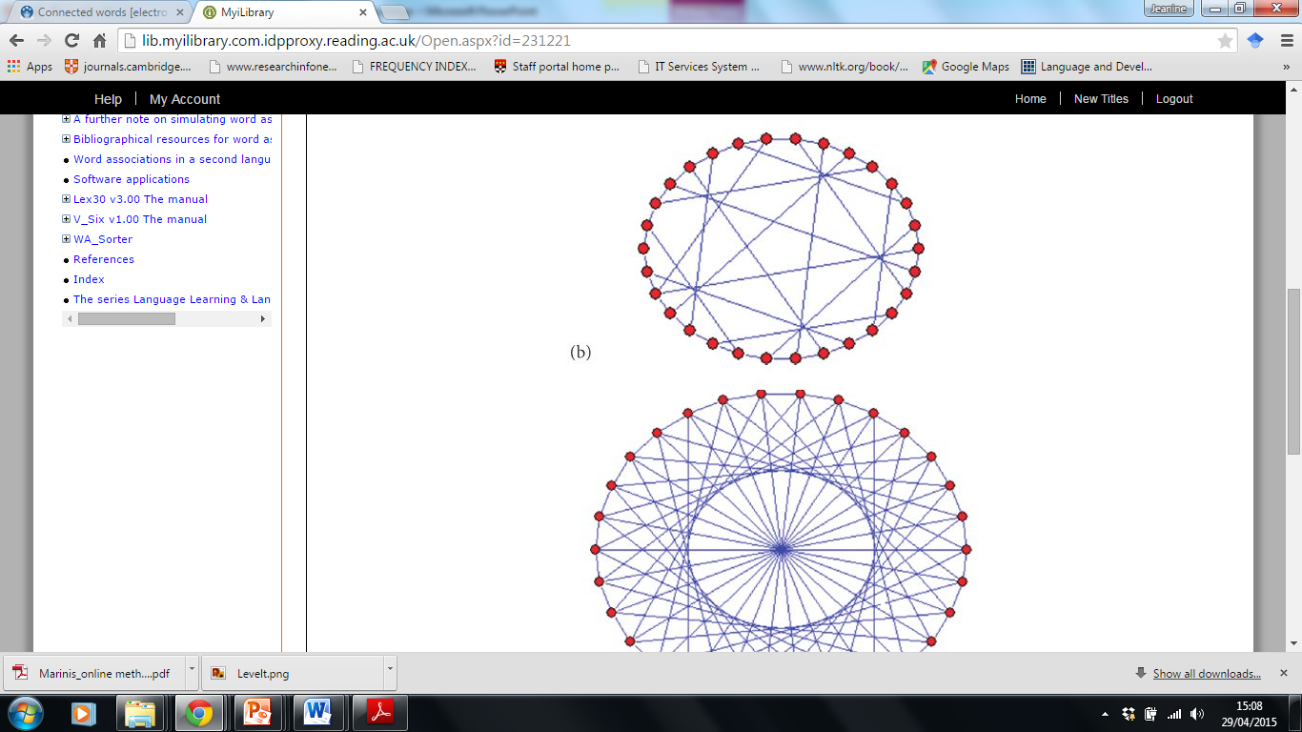
Associative networks
Size (how many points in the network)
Valency (how many connections each point has)

Slide 18
Models of lexical access
What is involved in accessing words during speaking or listening?
If a speaker wants to say “cat”, what steps does s/he need to make to do so?
What steps does the listener need to take to understand “cat”?

Slide 19
Speaking
Mental representation, referent, then sounds
First native language word, then pronunciation, articulatory movements
Mental connections, associations very strong
Willingness – abstract, no referent, need first language more – morphogical encoding

Slide 20
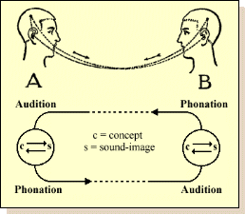
Phonation audition circuit (Saussure, 1916)
The mental facts (concepts) are associated with the representations of the linguistic sounds (sound-images). A given concept unlocks a corresponding sound-image in the brain; this purely psychological phenomenon is followed in turn by a physiological process: the brain transmits an impulse corresponding to the image to the organs used in producing sounds.
Notes:
Suppose that the opening of the circuit is in A's brain, where mental facts (concepts) are associated with the representations of the linguistic sounds (sound-images) that are used for their expression. A given concept unlocks a corresponding sound-image in the brain; this purely psychological phenomenon is followed in turn by a physiological process: the brain transmits an impulse corresponding o the image to the organs used in producing sounds. Then the sound waves travel from the mouth of A to the ear of B: a purely physical process. Next, the circuit continues in B, but the order is reversed: from ear to the brain, the physiological transmission of the sound-image; in the brain, the psychological association os the image with the corresponding concept. If B then speaks, the new act will follow--from his brain to A's--exactly the same course as the first act and pass through the same successive phases. . . . I have included only the elements thought to be essential, but the drawing brings out at a glance the distinction between the physical (sound waves), physiological (phonation and audition), and psychological parts (word-images and concepts)

Slide 21
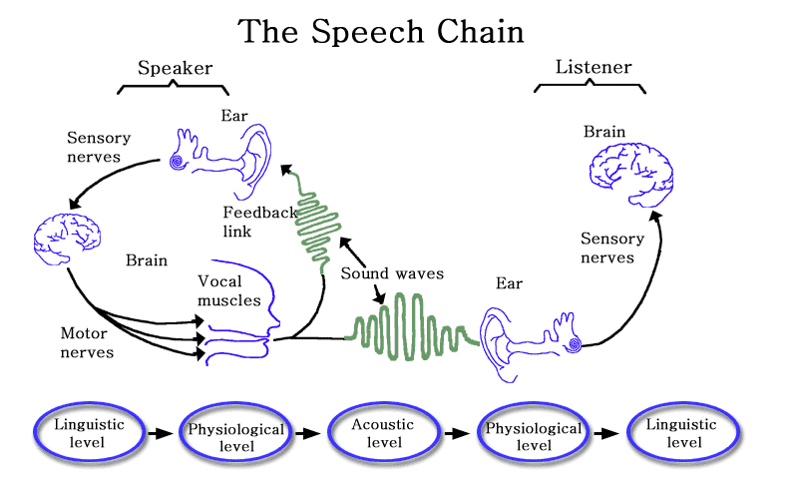
The speech chain
Laboratory on the Physiology, Acoustics, and Perception of Speech, Fall 2001. MIT open courseware.

Slide 22
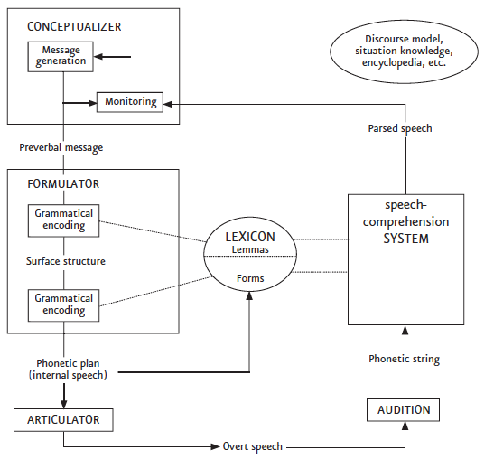
Levelt’s (1989) blue-print of the speaker

Slide 23


Icons
Icons – signifier bears a close relationship to the signified they refer to.
a photograph of a person;
a road sign with a person
Onomatopoeic words: whisper, cuckoo, splash, crash

Slide 24
Levelt’s blueprint of the speaker
Macro planning:
selection of information to be expressed.
elaboration of communicative goal into a series of subgoals (e.g. route direction) – spatio-temporal images
Microplanning:
Shaping of the message to turn it into a propositional form: a preverbal message (topic, focus; perspective)
I will send you the money next week
The money I will send you next week (“topicalized”)

Slide 25
Incremental processing
Processing is not strictly serial: planning, encoding and articulating can run in parallel.
The next processor works on the still incomplete output of the previous processor.
Look ahead. Compare the pronunciation of:
Sixteen
Sixteen dollars
Notes:
Stress in isolation: sixTEEN
In group: SIXteen DOllars

Slide 26
Executive control and automaticity
Controlled and automatic processing
Are the different components of the processing model subject to central, executive control?
Automatic processes are executed without intention or conscious awareness.
- Inflexible, hard to alter
- fast
Controlled processes demand attentional resources
Attention only for a few things in working memory
Level of awareness
Serial
slow

Slide 27
Controlled and automatic processing
Conceptualiser: highly controlled processing
Message construction and monitoring (self-corrections done with awareness)
All other components: largely automatic.
We don’t need to reflect on whether to make the recipient of give an indirect object/oblique object
Many conversational skills (deciding when and how to take a turn) are well-known procedures – not invented time and again
Selection of 2 to 3 words per second. Too fast for conscious processing.
Notes:
Marginal forms of executive control: you can halt speech when you detect an error.

Slide 28
Word associations in L2 learners
L2 learners’ word associations differ from those of native speakers
Less stable, idiosyncratic
Links between words in the L2 lexicon are tenuous, quickly overridden by phonological similarities.
What happens to new words that are acquired?

Slide 29
Associative chains
Can you make links between the following words?
How do we get from publication to captivity?
Publication – journalist – illegal -captivity
1. cold…. desire
2. temptation…. conqueror
3. benefit…. witness (Meara, 2009)

Slide 30
1. cold…. Desire: cold warm tea desire
Cold light depressed desire
Cold food fish and chips desire
2. temptation…. Conqueror
Temptation power battle conqueror
3. benefit…. Witness
Benefit smuggle crime witness

Slide 31
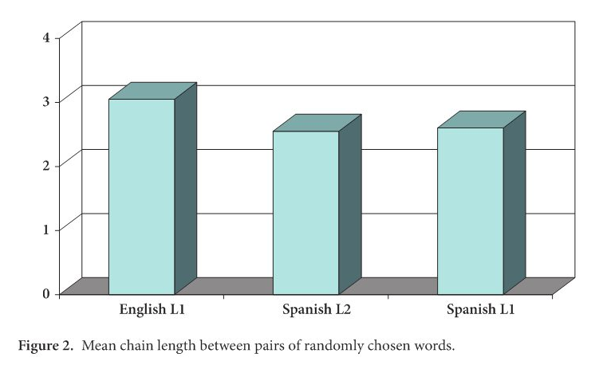
Word associations in L2
Smaller valencies?
Longer associative chains in L2?

Slide 32
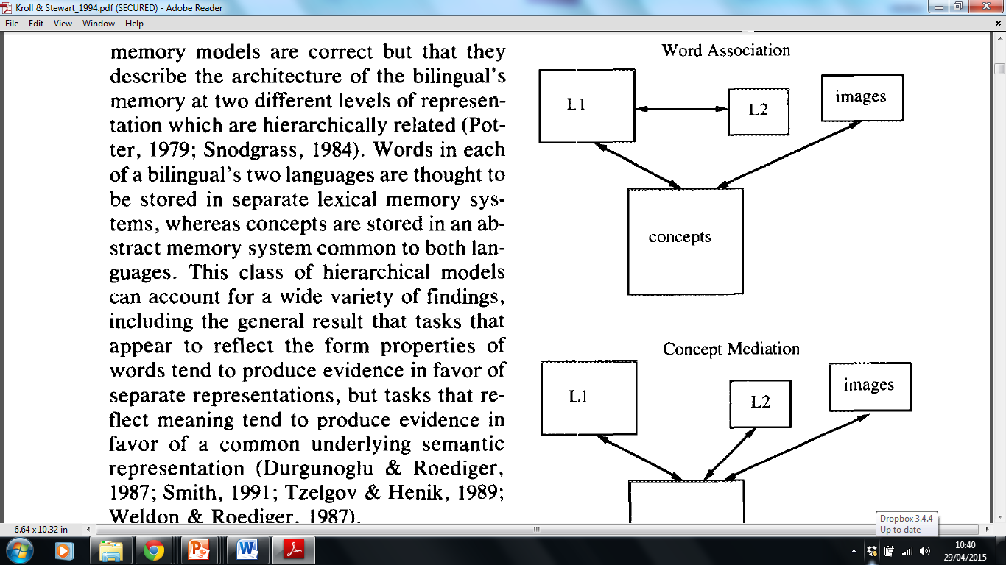
Early models of lexical access in L2
WAM:
It should take longer to name a picture in the L2 than to
translate
from L1 to L2

Slide 33
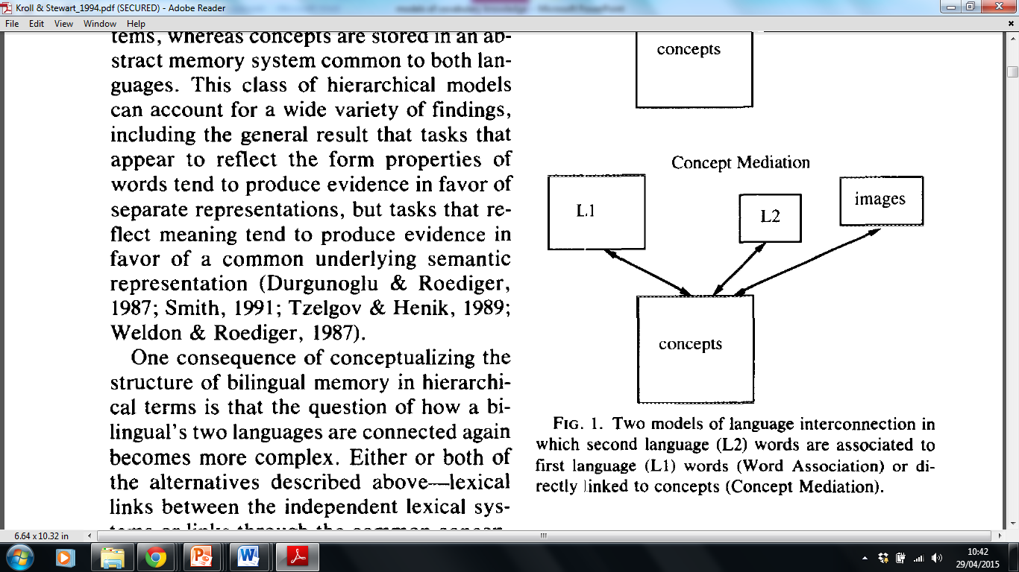
Early models of lexical access
Concept mediation:
Naming a picture and translation
should take equally long

Slide 34
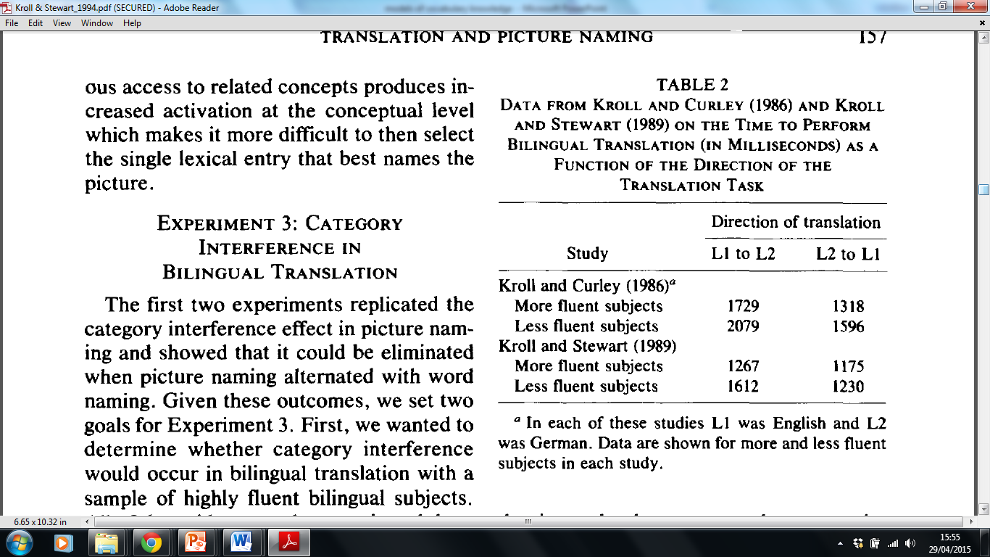
But… forward and backward Translation

Slide 35
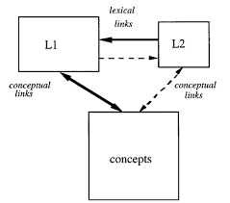
Revised hierarchical model (Kroll & Stewart, 1994)
Longer translation latencies from L1 to L2 (forward translation) than from L2 to L1 (backward translation) due to underlying asymmetry in the strength of the links between words and concepts in each of the bilingual's languages.
Notes:
The L1 was hypothesized to have privileged access to meaning, whereas the L2 was thought to be more likely to require mediation via the L1 translation equivalent until the bilingual acquired sufficient skill in the L2 to access meaning directly.

Slide 36
RHM (Kroll & Stewart, 1997)
Translation from L2 to L1 is done on a lexical basis
Translation from L1 to L2 is done via the concepts

Slide 37
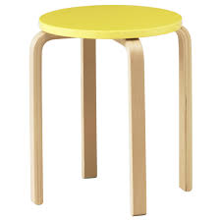
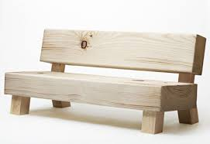
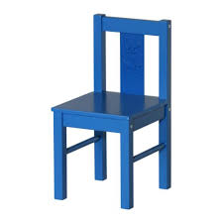

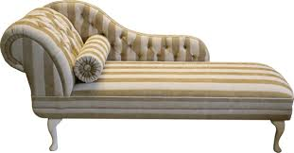
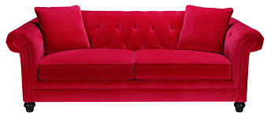
How do we call these in our languages? What are the relevant properties that distinguish between them?

Slide 38
Different languages/cultures cut up reality in different ways
English
bank
bench
sofa/couch

Slide 39
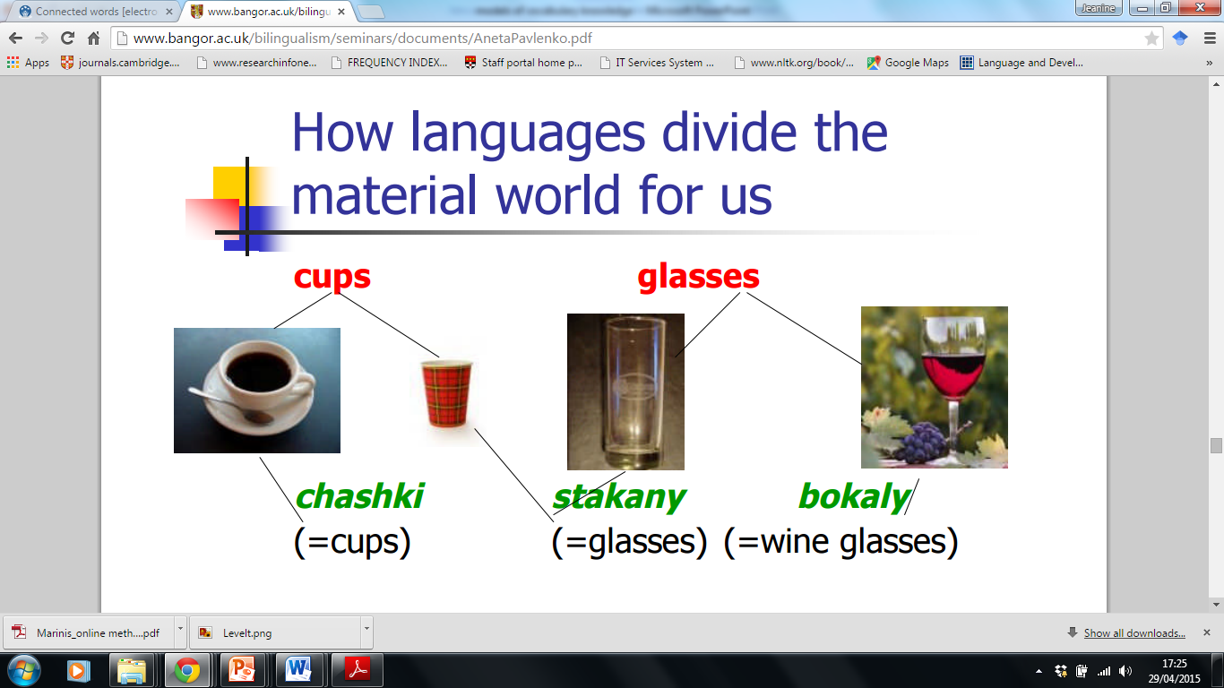
Pavlenko (2011)

Slide 40
Critique: concepts not always shared between languages
Pavlenko (2011)
Conceptual equivalence of L1 and L2 translation equivalents (e.g., book/kniga)
Partial (non-) equivalence: translation equivalents linked to overlapping – but not identical – conceptual categories (e.g., cup/chashka)
Conceptual non-equivalence: one language encodes a concept that the other doesn’t (e.g., privacy)

Slide 41
Concepts in L1 and L2 (Pavlenko)
Use of L1 categories in L2 performance (e.g., frustration)
Avoidance of L2 categories in L2 performance (e.g., perezhivat’)
Internalization of L2 categories (e.g., privacy in L2 English)
Use of L2 categories in L1 performance (e.g., privacy in L1 Russian)
Avoidance of L1 categories in L1 (e.g., perezhivat’ in L1 of late Russian-English bilinguals)

Slide 42
Differences between languages
Languages differ in the ways they express the world around us.
Concepts are more codable in one language than in the other.
Differences in aspect in English (progressive/non-progressive)
(1) he drinks tea (habit)
(2) he is drinking tea (ongoing action)
One form in French
(3) Il boit du thé
Notes:
Codability: ease of expression of the relevant categories In psycolinguistic terms, a more codable expression is more accessible: I.e. it is short, and/or high frequency, and generally part of a small set of optionsin a paradigm or small set of itmes.
Thus: a concept expressed by a single verb is more codable than a phrase or clause: run versus while running
Examples: colour terms

Slide 43
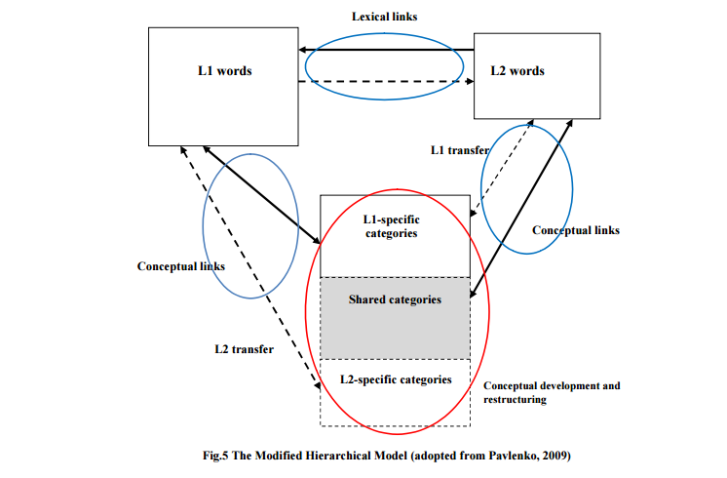
Modified Hierarchical model (Pavlenko, 2014)

Slide 44
questions
Can L2 learners develop the same knowledge of words as L1 learners?
What differences might there be?
Discuss

Slide 45
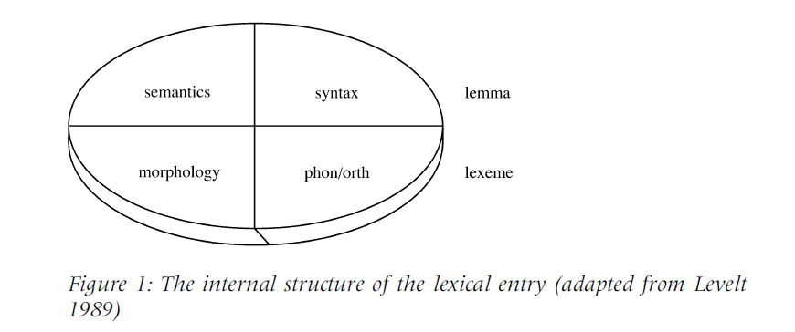
Lexical representation in L1
(Jiang, 2000; 2002)
Notes:
Part of speech, word meaning: lemma
Morphological variants, spelling, pronunciation: lexeme

Slide 46
Lexical representation in L1
Automatic, simultaneous activation of different kinds of information
Phonological activation in visual word recognition
Integration of different kinds of information can only be achieved after highly contextualized exposure
Child extracts different kinds of information while being exposed to the word form
Is this also possible in L2 learning?

Slide 47
Lexical representation in L2
Differences from L1 lexical representation:
Lack of large quantities of rich input
Presence of an L1 semantic system
In L1 acquisition: task is to understand and acquire the meaning of a word and other properties
In tutored L2 acquisition: task is to remember the word
Meanings of L2 word are understood via the L1 translation
Established semantic system blocks creation of new meanings associated with L2 form

Slide 48
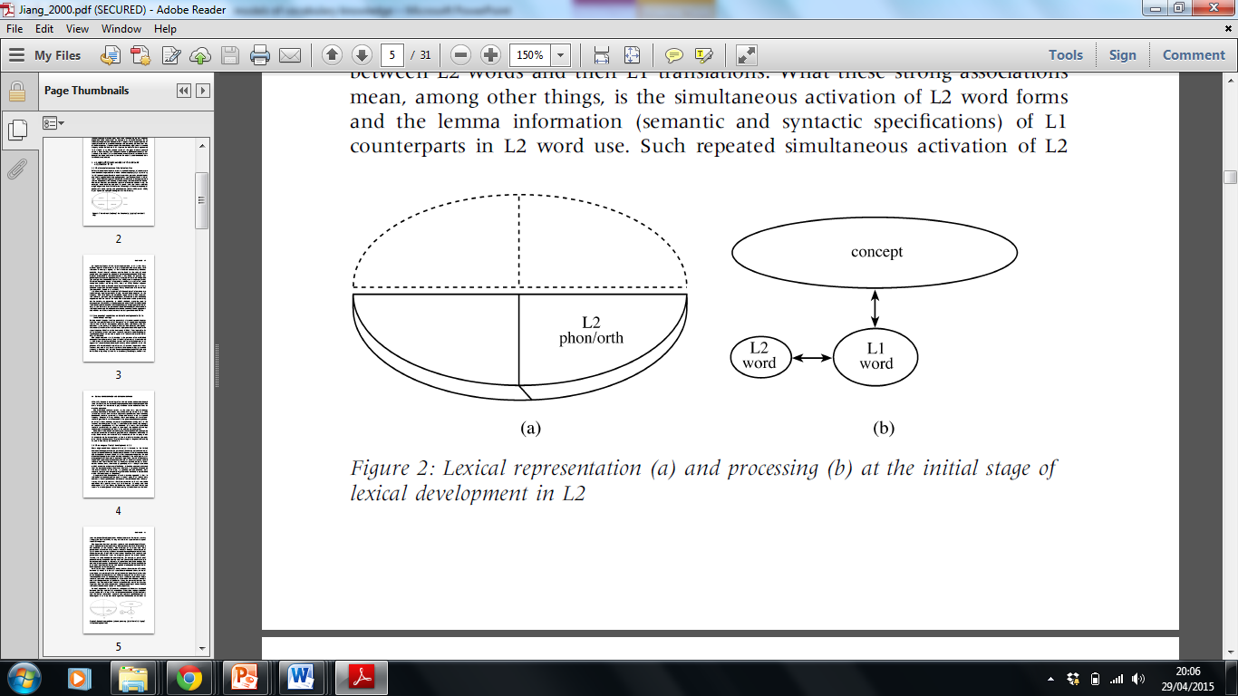
Initial stage of L2 lexical representation (Jiang, 2000)
Formal stage
Lexical entry only contains formal specifications, with a pointer to the L1 word.
Notes:
Compatible with Potter’s word association model

Slide 49
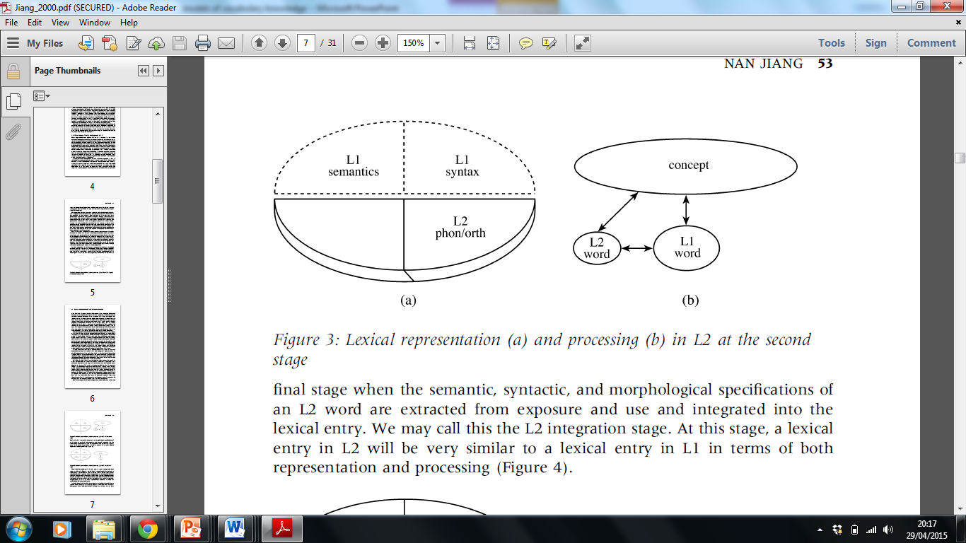
Second stage
L1 lemma mediation stage: L1 lemma is copied onto the L2 entry:
No morphological information available

Slide 50
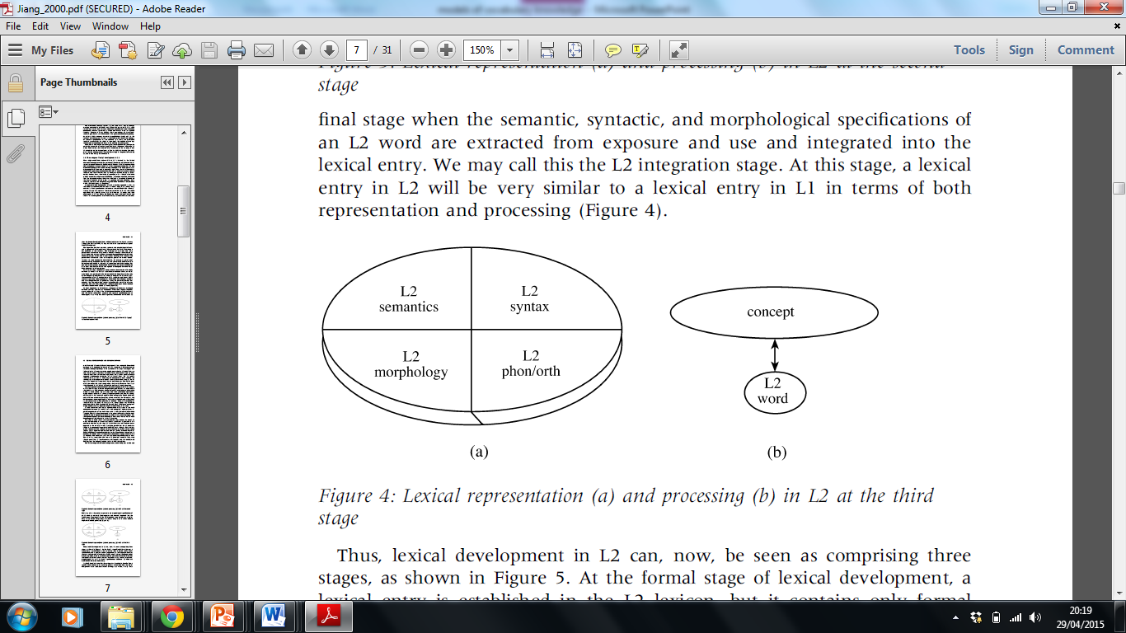
Third stage
L2 integration stage
Semantic, syntactic and morphological information from L2 word integrated into the L2 entry.

Slide 51
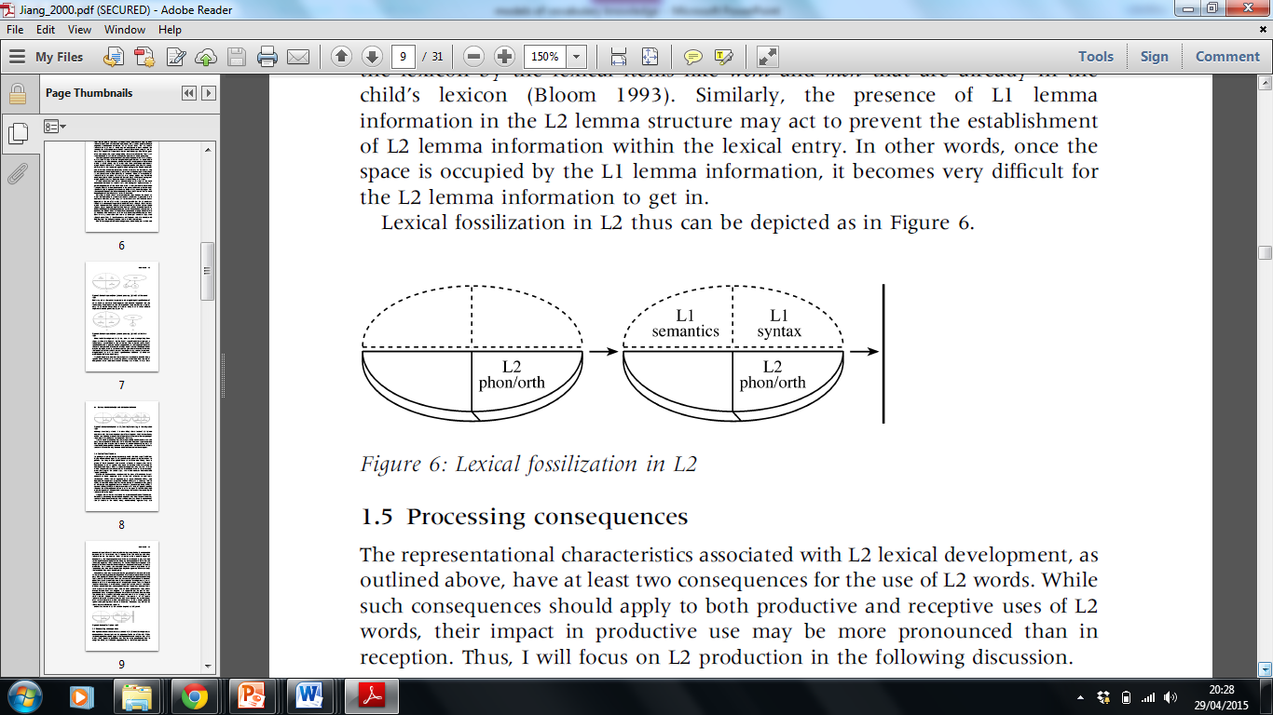
Lexical fossilization
L2 learners often stop at the second stage, even when extensive contextual input is available.
Increased exposure reinforces link between L2 form and L1 lemma
L2 learners are not able to utilize the information available to them (Ellis, 1994)
L1 lemma mediation is a major cause of lexical fossilization
Notes:
L2 learners’ words can be at different stages of development

Slide 52
Research evidence
Translation recognition task with four types of word pairs (Talamas et al. 1995)
translation equivalents
form related
semantically related
unrelated
Low level and high level learners
How does language level affect results?
Form interference
Semantic interference

Slide 53
Storing of words
Are words from L1 and L2 stored separately?
Lexical access is non-selective

Slide 54
Sources
De Beaugrande, Robert (1991) Linguistic Theory. The discourse of fundamental works. London and New York: Longman
Joos, Martin (ed.) (1957, 1966) Readings in Linguistics 1, Chicago and London: The University of Chicago Press
Lepschy, Giulio C. (1972) A survey of structural linguistics.London: Faber and Faber
Saussure, F. Course in general linguistics / / edited by Charles Bally and Albert Sechehaye, translated and annotated by Roy Harris. Publication info: Duckworth, 1983
Notes:
http://www.thefreelibrary.com/Recycling+inversion:+the+case+of+initial+adverbs+and+negators+in...-a092683479

